Slide 1
Tableau Predictive Analytics
Warsha Mhetre

Slide 2
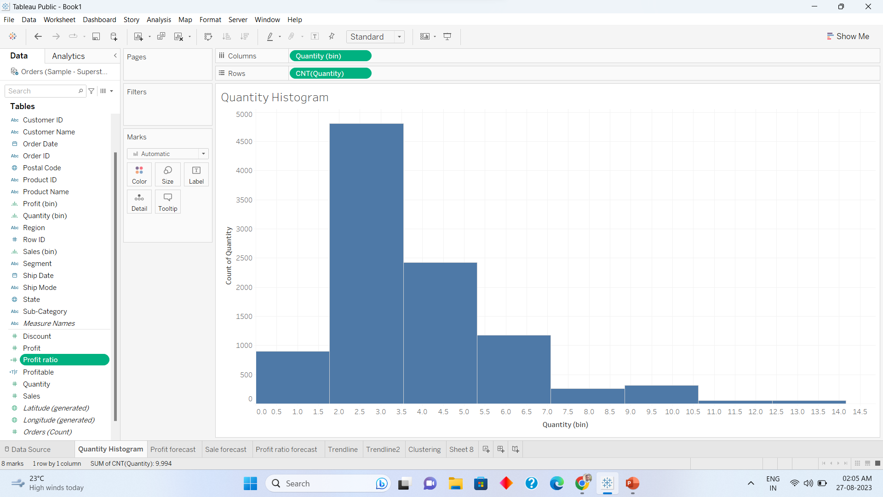
Histogram in Tableau

Slide 3
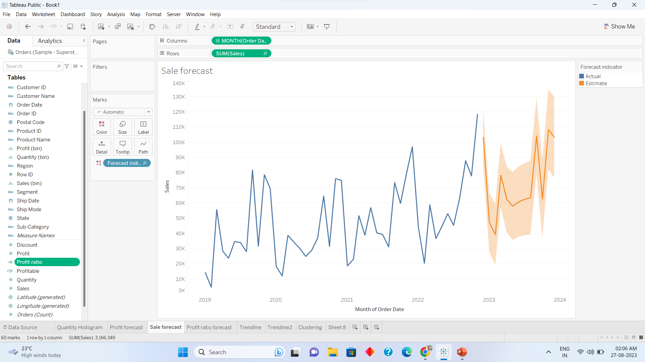
Forecasting Sales

Slide 4
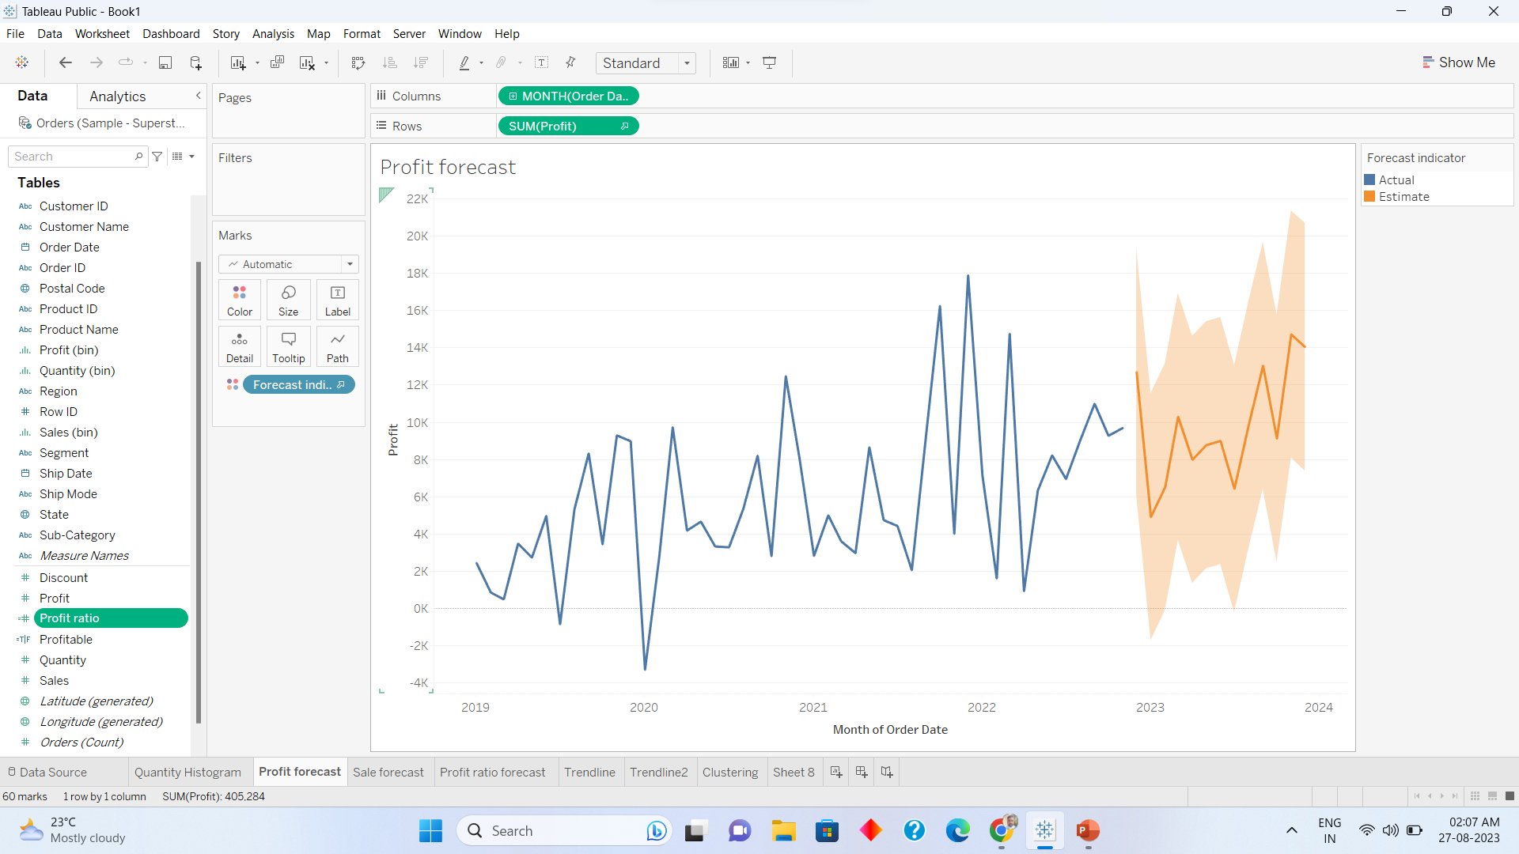
Forecasting profit

Slide 5
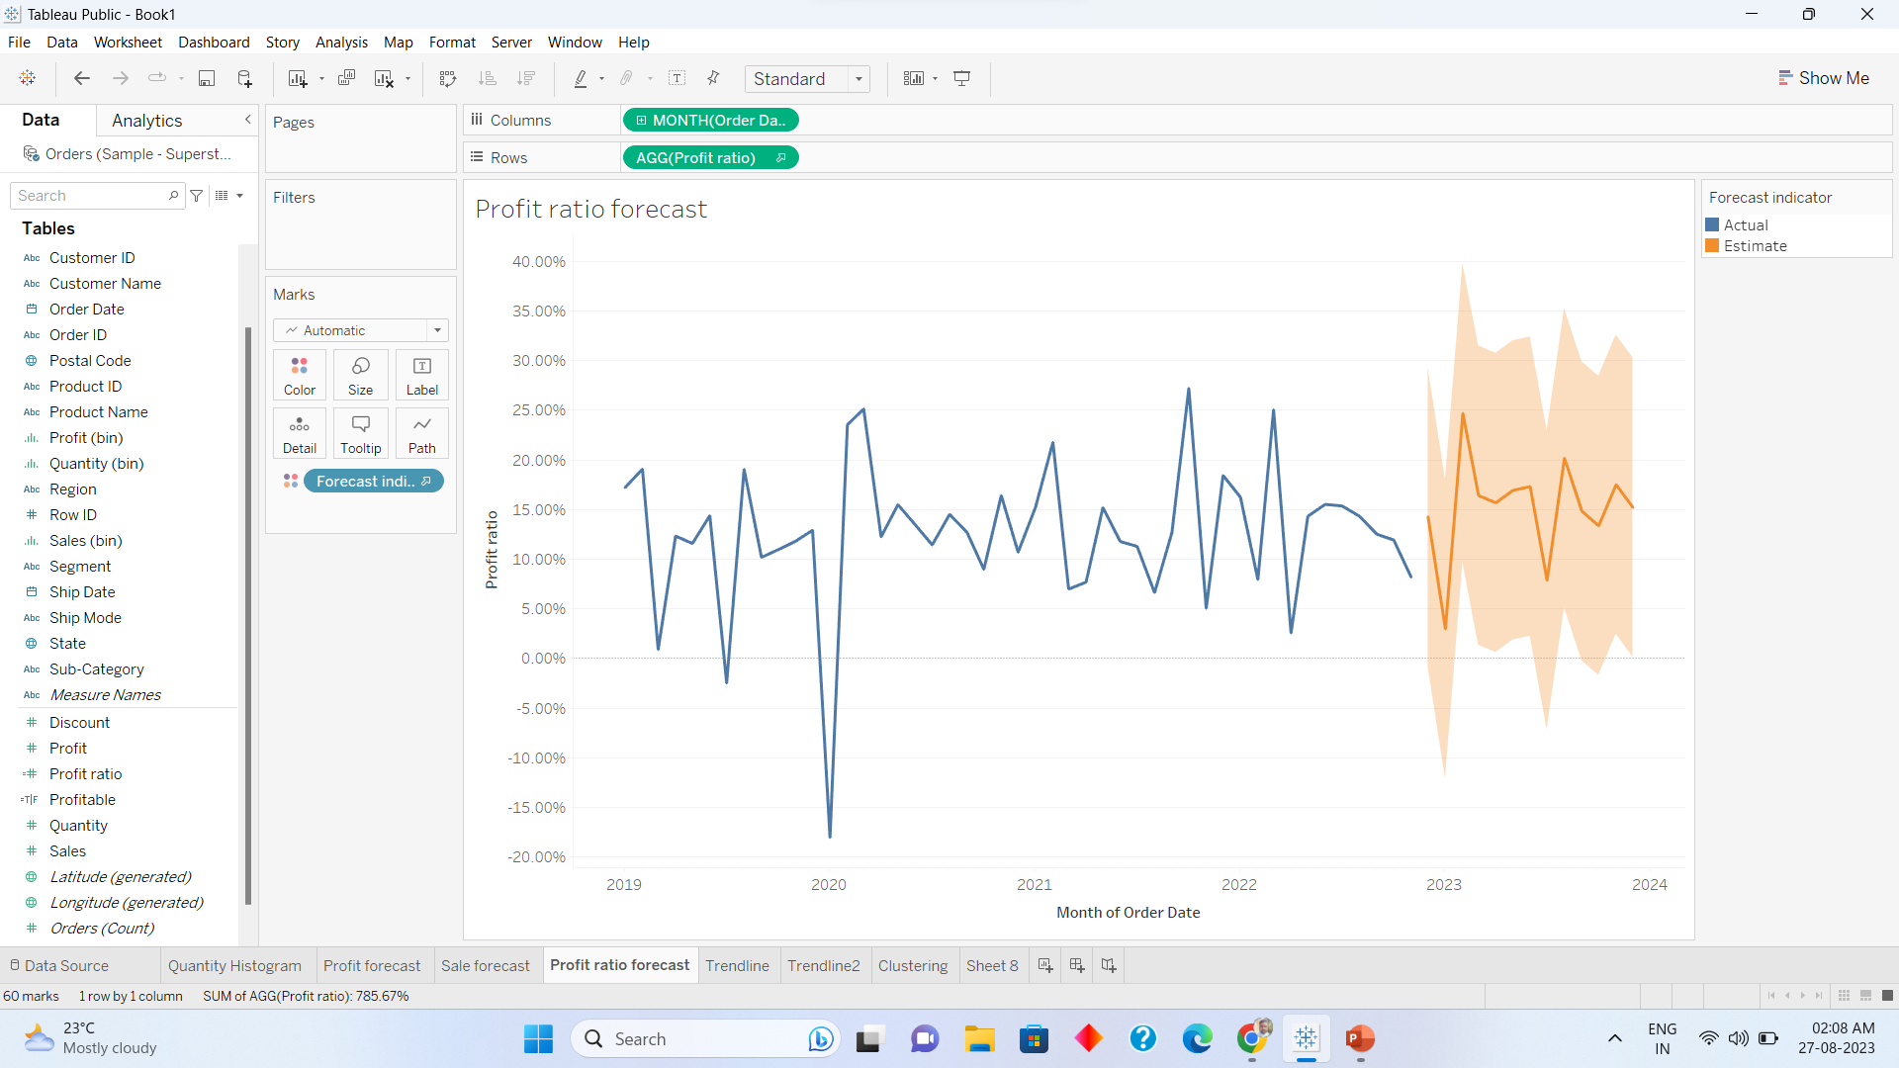
Forecasting sales to profit ratio

Slide 6
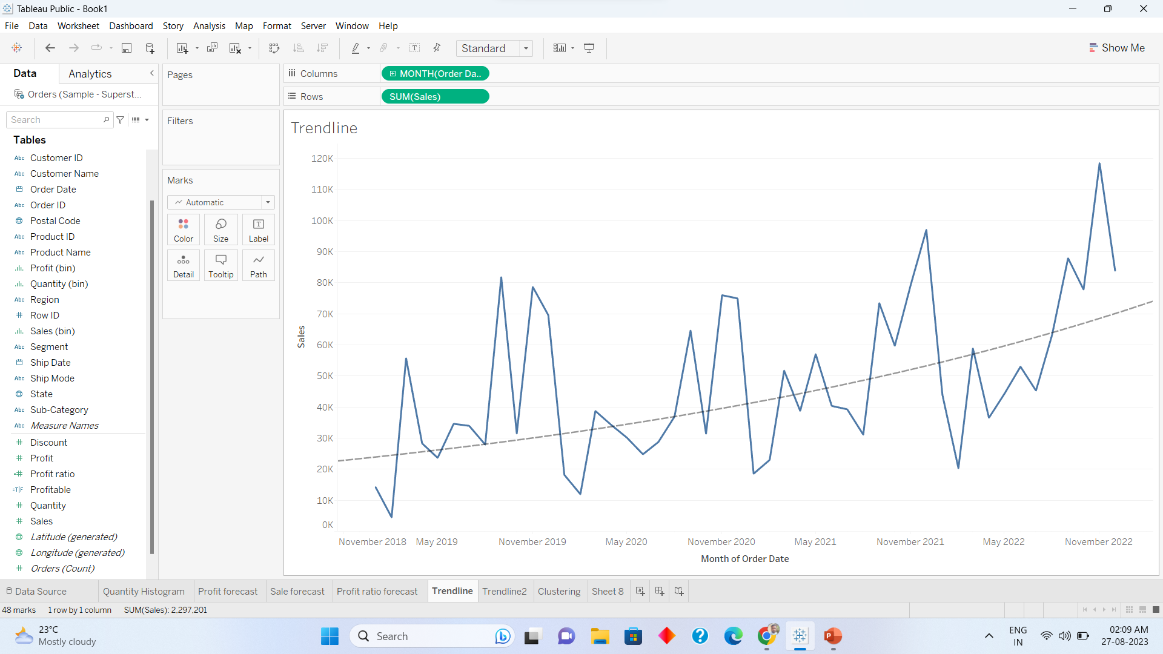
Trendline to Sales chart

Slide 7
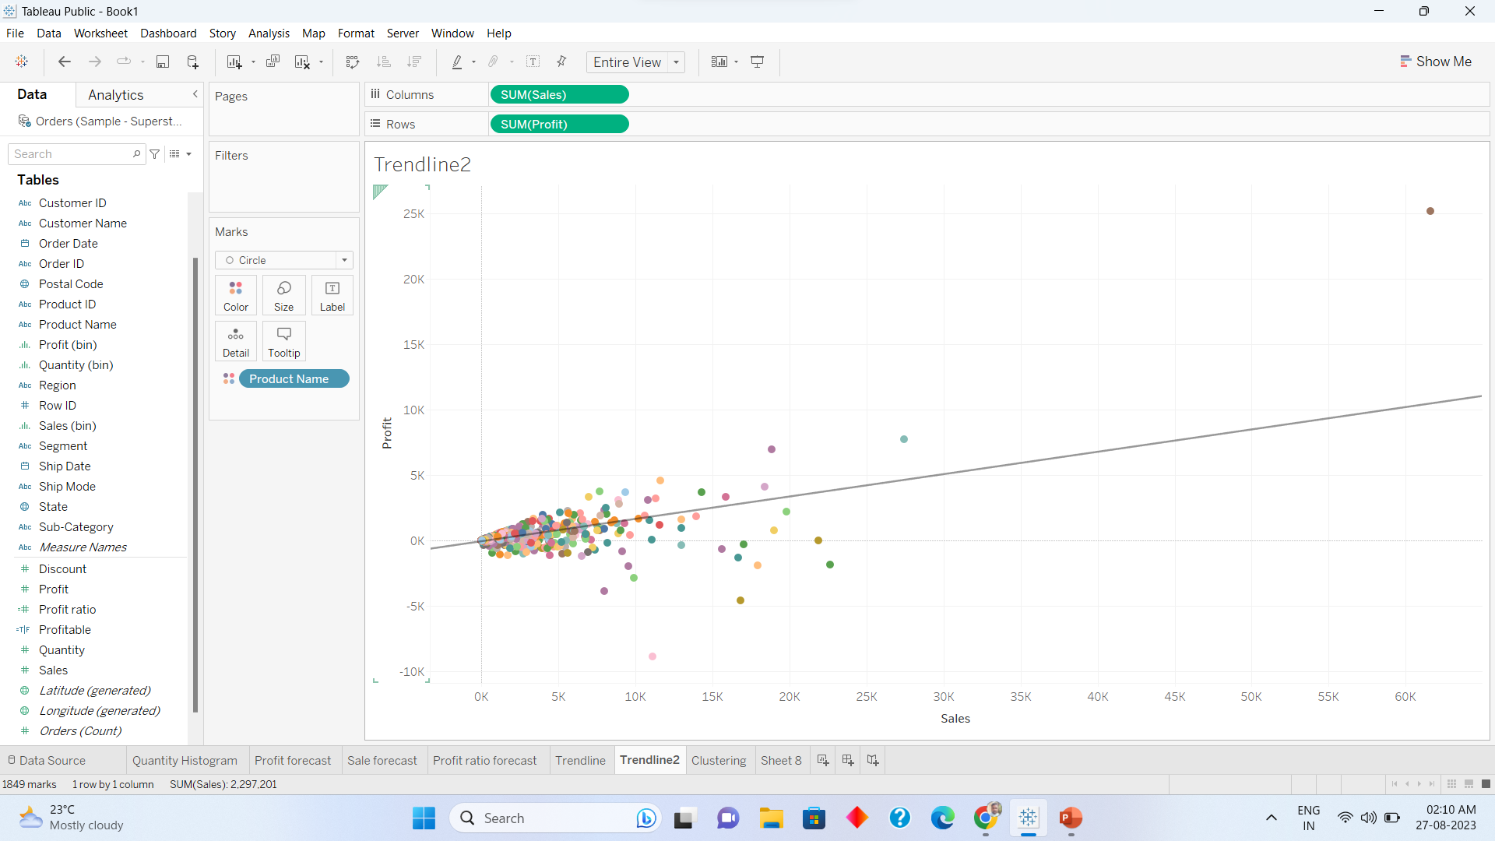
Trendline Sale vs Profit product wise

Slide 8
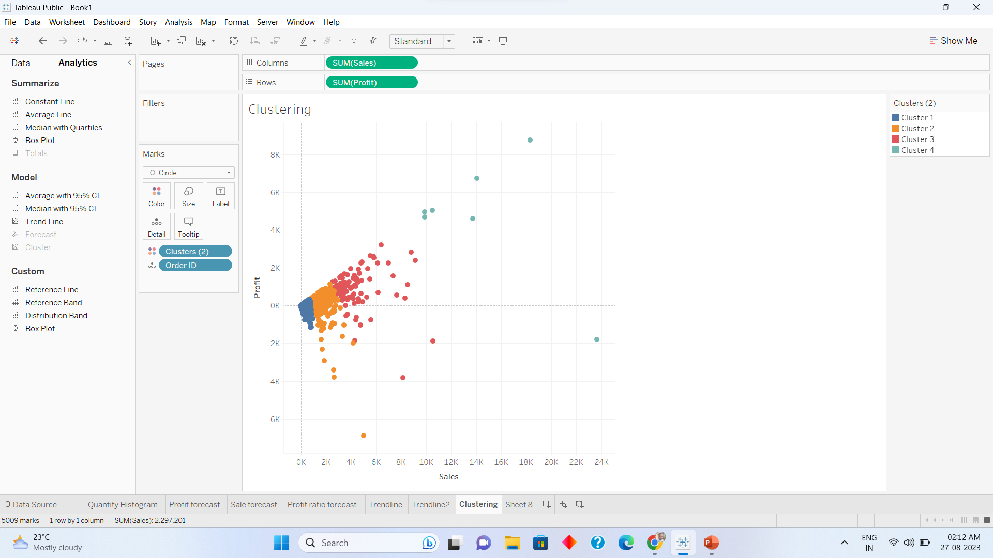
Clustering order wise Sales vs Profit

Slide 9
Thank you
Warsha mhetre

